Slide 1
New features are now available in Microsoft Edge
11:45
The new Microsoft Edge is here. You can use the fastest version today.
Wednesday, April 29
Team Dinner
Bento Box
6:00 PM - 10:00 PM
12
13

Slide 2
New features are now available in Microsoft Edge
11:45
The new Microsoft Edge has all of the features you love and more
Wednesday, April 29
Team Dinner
Bento Box
6:00 PM - 10:00 PM
12
13

Slide 3
Like what you see?
Have you tried the new features available in Edge?
11:45
Windows Insiders are invited to try the new Microsoft Edge
Wednesday, April 29
Team Dinner
Bento Box
6:00 PM - 10:00 PM
12
13

Slide 4
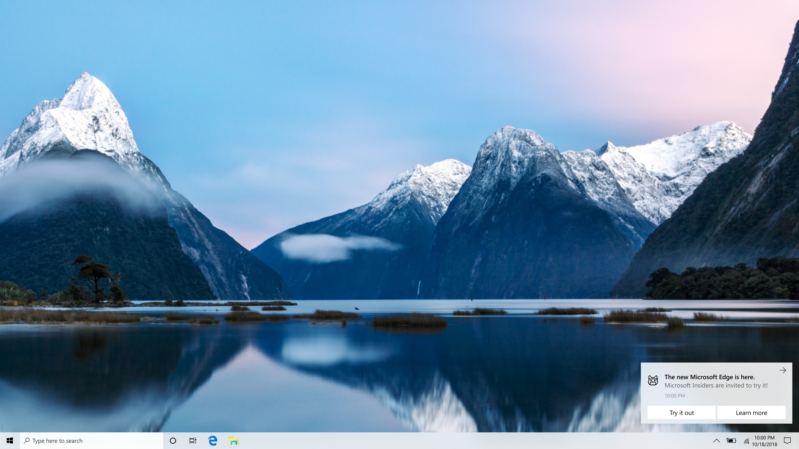
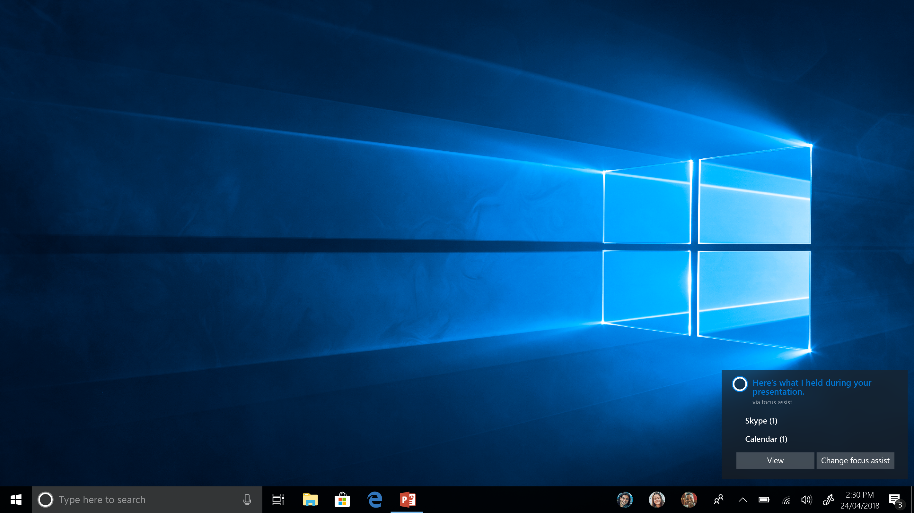
U
New Microsoft Edge is here
Microsoft Insiders are invited to try the new Microsoft Edge
Try it out (B1) Learn more (B2)
Glyph: ninja cat

Slide 5
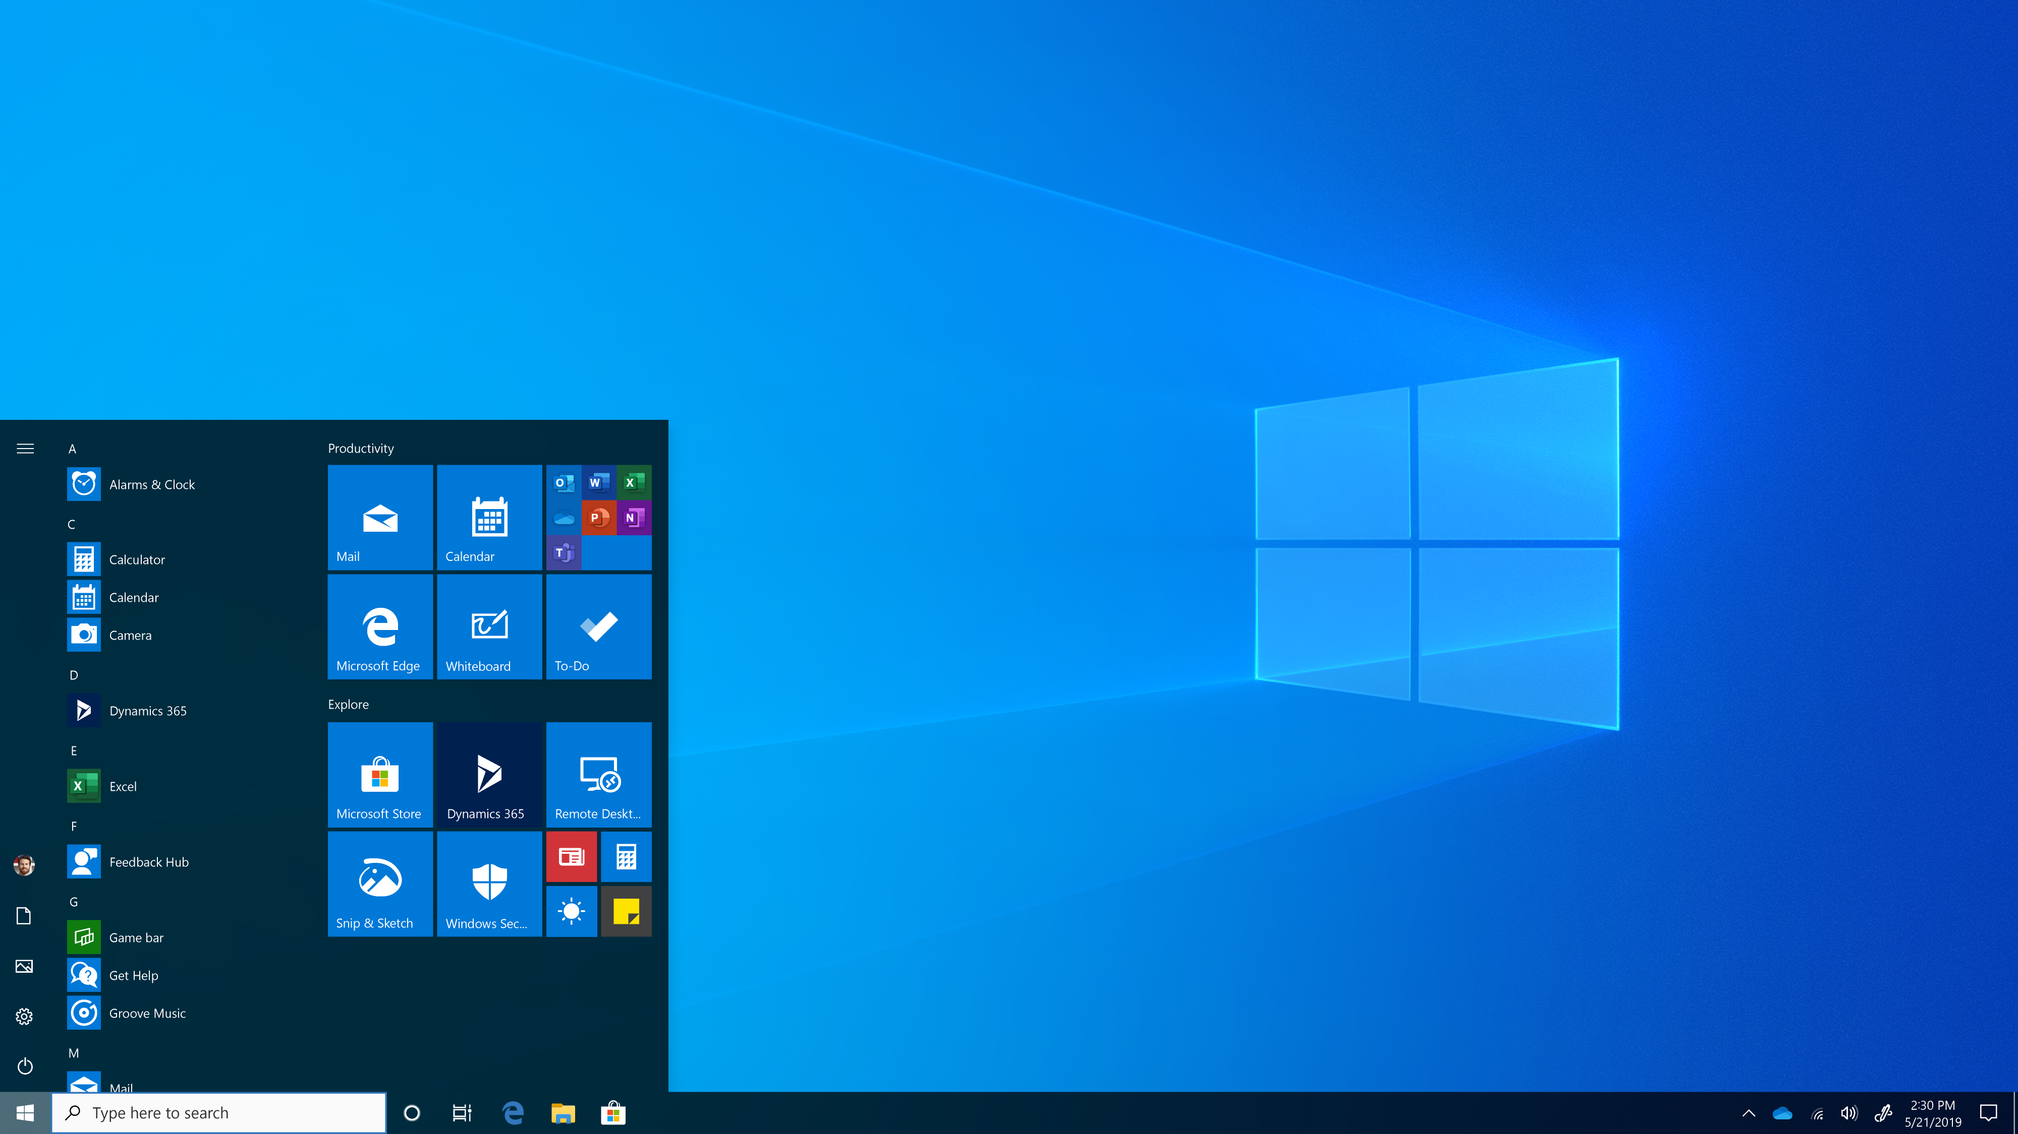
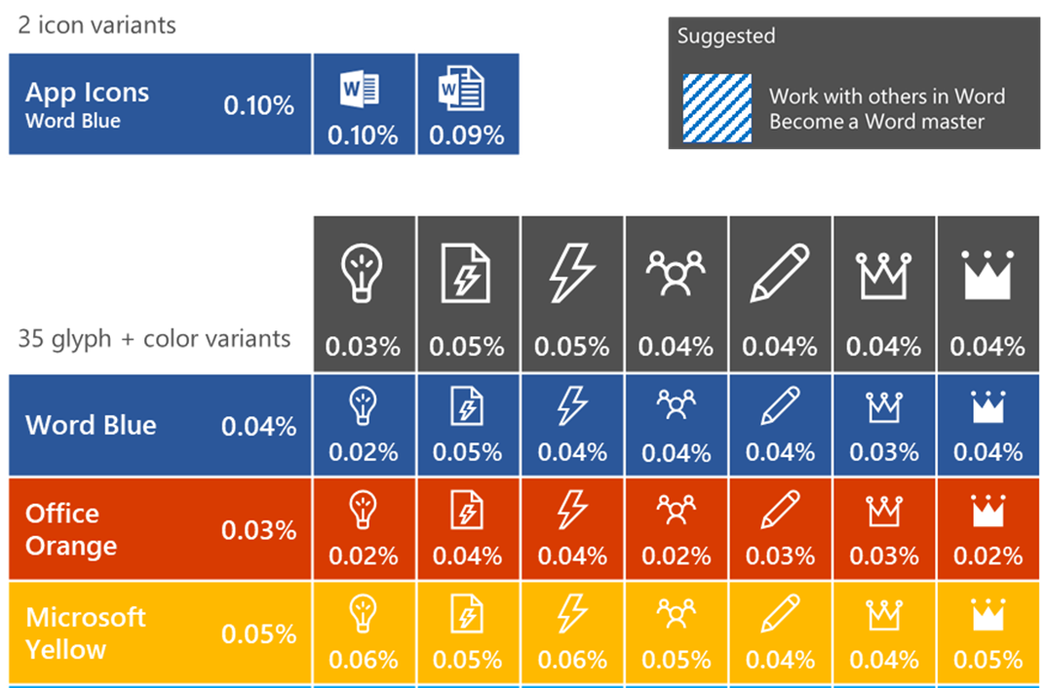
U
Start Menu Suggestions experiment mocked after Office 365 test
Title | Body text
Try Microsoft Edge | See the features
The new Microsoft Edge | Try the features
Microsoft Edge is new | Try it out
Get extensions on Edge | Built on Chromium
Try dark theme in Edge | Get the new browser
New Microsoft Edge is here | Try dark theme
Collections on Microsoft Edge | Try the new browser
Suggested
The new Microsoft Edge
Built on Chromium

Slide 6
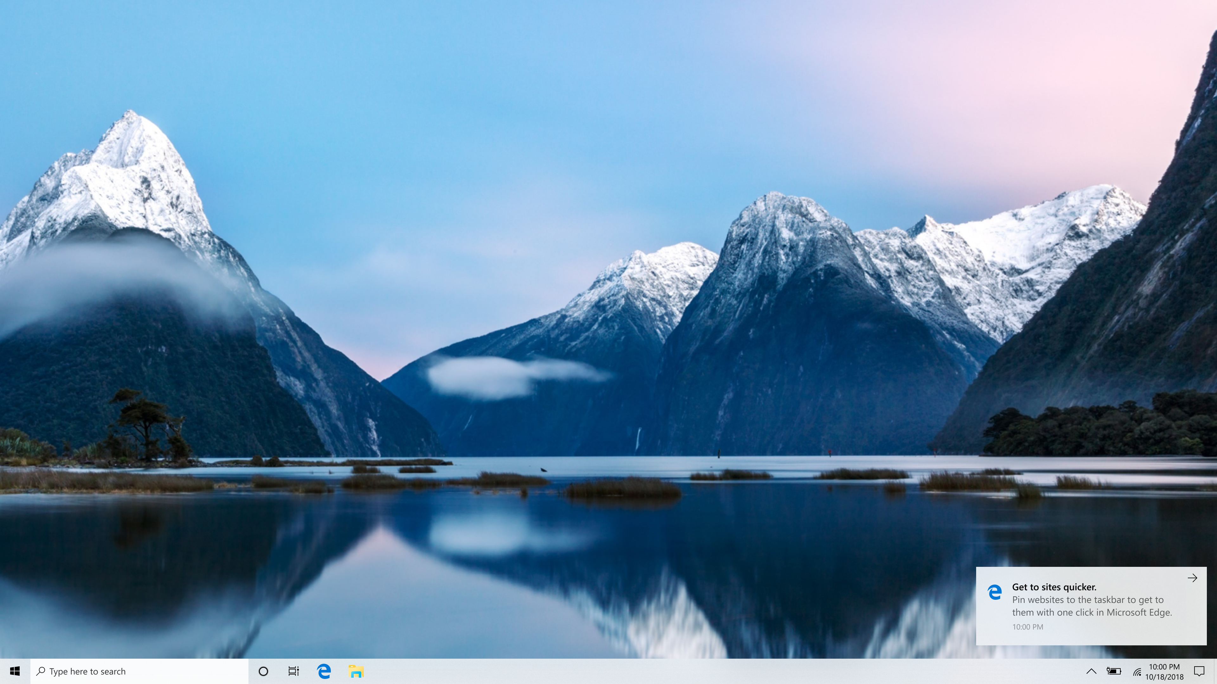
U
Get to sites quicker
Pin websites to the taskbar to open them with one click in Microsoft Edge
Glyph: Edge icon

Slide 7
Suggested
The new Microsoft Edge
Built on Chromium

Slide 8
U
Like what you see?
Personalize your web browsing by choosing a theme
11:45
Try a different look in your browser
You can personalize Microsoft Edge with a light theme or dark theme
Try it out
Wednesday, April 29
Team Dinner
Bento Box
6:00 PM - 10:00 PM
12
13
Notes:
Personalize your browser

Slide 9
R
Like what you see?
The new Microsoft Edge has the latest features
11:45
You can sync your favorite websites from Chrome into the new Microsoft Edge
Sync my favorites
Wednesday, April 29
Team Dinner
Bento Box
6:00 PM - 10:00 PM
12
13

Slide 10
R
Like what you see?
Organize your tabs and windows with Collections
11:45
The Collections feature in Microsoft Edge helps you collect, organize and share content as you travel across the web
Learn more
Wednesday, April 29
Team Dinner
Bento Box
6:00 PM - 10:00 PM
12
13

Slide 11
R
Like what you see?
Personalize Microsoft Edge with popular extensions
11:45
Boost the power of your browser with extensions for Microsoft Edge
Wednesday, April 29
Team Dinner
Bento Box
6:00 PM - 10:00 PM
12
13

Slide 12
U
New Microsoft Edge is here
Microsoft Insiders are invited to try the new Microsoft Edge
Try it out (B1) Learn more (B2)
Glyph: ninja cat

